Slide 1

Flooding: What does FSMA Say?

Slide 2
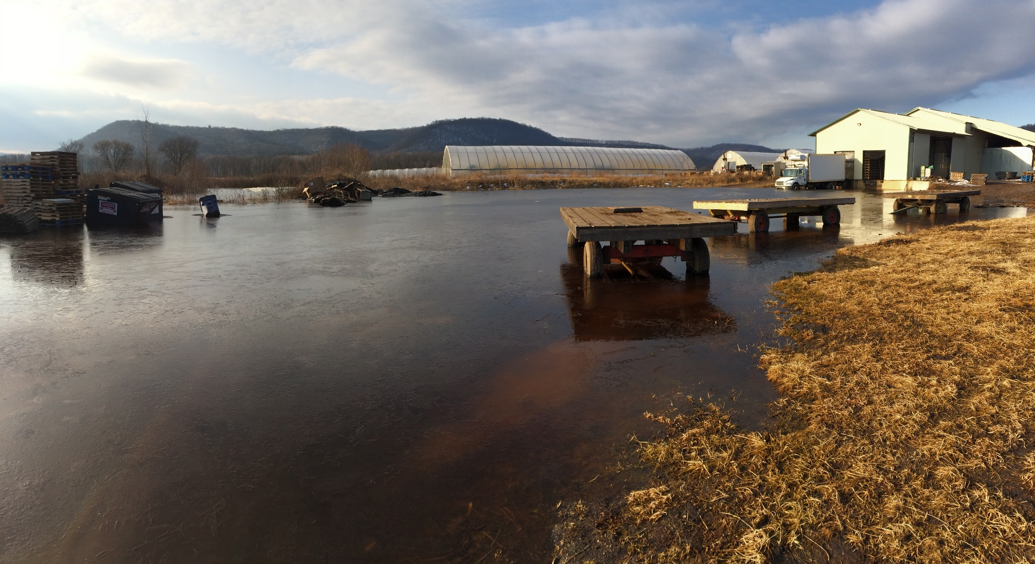
Flooding Minnesota
Property of Dan Fillius, Iowa State University

Slide 3
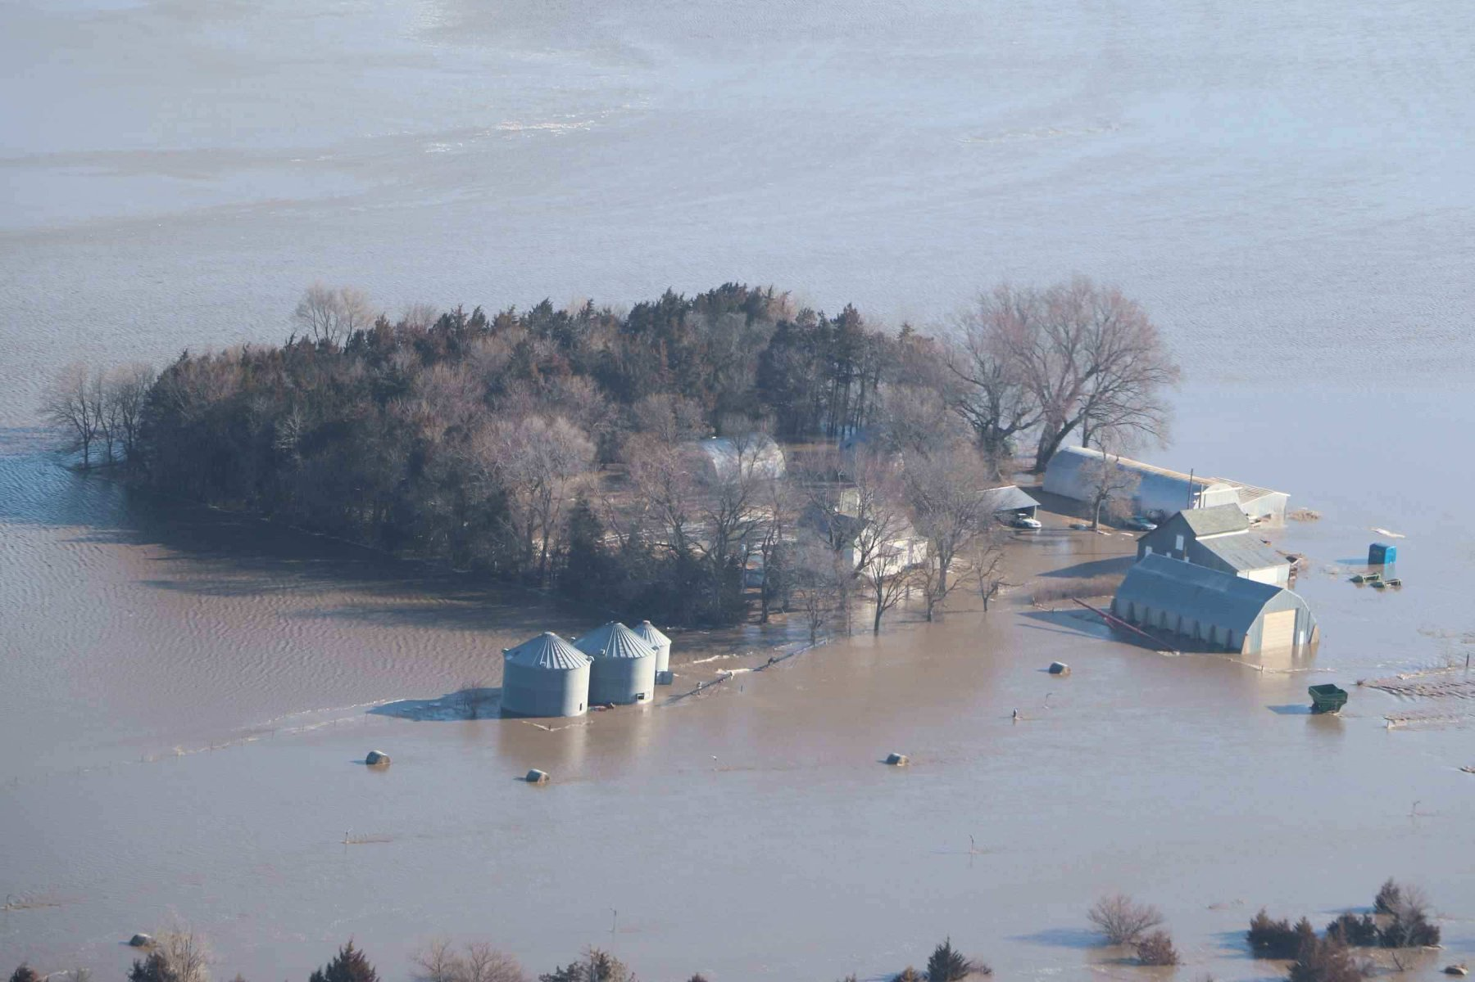
Lands in Nebraska
https://homesteadersofamerica.com/nebraska-farms-flooded-and-how-it-affects-everyone/

Slide 4
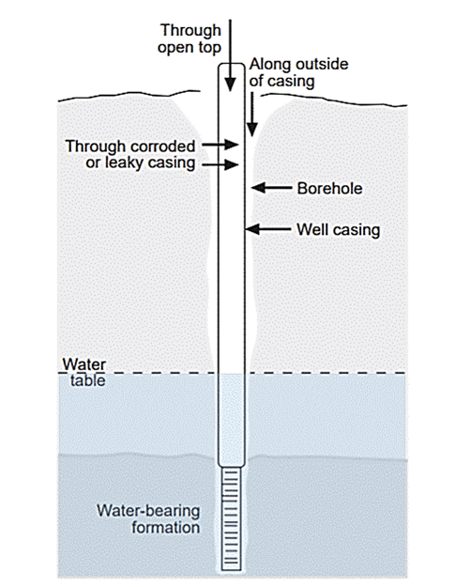
Contaminants enter through well defects or other easy pathways
Property of Shawn Shouse, Iowa State University, Written permission needed to use

Slide 5
Definitions
Flooding is the flowing or overflowing of a field with water outside a grower’s control
Pooled water (e.g., after rainfall) that is not reasonably likely to cause contamination of the edible portions of fresh produce is not considered flooding

Slide 6
About Edible Portion of Crop
If the edible portion of a crop is exposed to flood waters, it is considered adulterated under section 402(a) (4) (21 U.S.C. 342(a)(4)) of the Federal Food, Drug, and Cosmetic Act and should not enter human food channels.
There is no practical method of reconditioning the edible portion of a crop that will provide a reasonable assurance of human food safety.
FDA recommends that these crops be disposed of in a manner that ensures they are kept separate from crops that have not been flood damaged to avoid adulterating "clean" crops

Slide 7
About Edible Portion of Crop
For crops that were in or near flooded areas but where flood waters did NOT contact the edible portions of the crops, the growers should evaluate the safety of the crops for human consumption on a case-by-case basis for possible adulteration

Slide 8
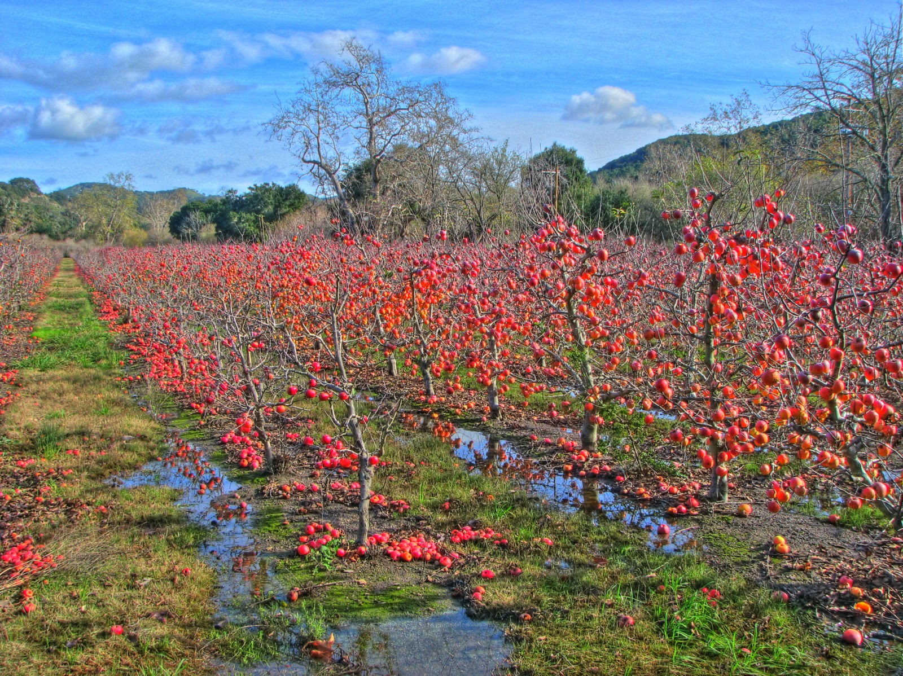
If edible portion was in flood water then…
http://www.natemaas.com/2010/12/naked-apple-trees.html

Slide 9
Evaluation if not in flood water
Assessment of flood water (biological, chemical, and physical hazards)
Type of crop and stage of growth
The likelihood for crops to absorb or internalize potential contaminants from flood waters and/or flooded soil
The degree and duration of crop exposure to flood waters and related conditions

Slide 10
Assessment of flood water
Petroleum leak, chemical spills, sewage, heavy metals, pathogenic microorganisms, other disasters due to flooding
How close is it to the farm/fields

Slide 11
Type of crop and stage of growth
The edible portion of the crop has developed after the flood water receded, or
The lowest edible portion of the crop was above the floodwaters level with minimum risk of contamination due to splashing; and
The crop can be harvested without cross-contamination from nearby environment, including flooded soil and flooded portion of the crop.

Slide 12
The likelihood for crops to absorb or internalize
Rate of uptake can vary depending on many factors, including contaminant type, plant species, and soil conditions
Some root crops absorb quicker

Slide 13
The degree and duration of crop exposure
The volumes of flood waters (how deep) and/or how long the flood waters were present in the field before receding.
How quickly the field began to dry out after flood waters receded, taking into consideration soil type, topography and drainage.
Whether conditions existed that exposed the crop to prolonged periods of moisture and stress which could foster fungal growth, and possibly, development of mycotoxins

Slide 14
Testing if not in flood water
Growers consider testing any one or more of the following contaminants
Sampling should be representative of the crop being evaluated and testing appropriate for the specific crop and flood situation
Growers discuss their testing plans with state and local FDA regulators and technical specialists for case-specific evaluations

Slide 15
Examples of tests
Mycotoxins
Heavy metals, including: cadmium, mercury, lead, and arsenic
Microbiological hazards of significant public health impact including human pathogens (e.g., Salmonella, E.coli O157:H7, other Shiga toxin-producing E. coli, Clostridium perfingens), viruses (e.g., Hepatitis A), and parasites (e.g., Cryptosporidium, Giardia)
Pesticides
Polychlorinated Biphenyls (PCBs)
Other contaminants as appropriate such as petroleum

Slide 16

Before Replanting in fields

Slide 17
Pre Planting Assessment
Assessing field history and crop selection.
Determining the time interval between the flooding event, crop planting, and crop harvest.
Determining the source of flood waters (e.g., drainage canal, river, or irrigation canal) and whether there are significant upstream potential contributors of human pathogens.
Allowing soils to dry sufficiently and be reworked prior to subsequently planting crops on formerly flooded production ground.

Slide 18
Pre Planting Assessment
Sampling previously flooded soil for the presence of microorganisms of significant public health concern or appropriate indicator microorganisms.
*Microbial soil sampling can provide valuable information regarding relative risks, but sampling by itself does not guarantee that all raw agricultural commodities grown within the formerly flooded production area are free of the presence of human pathogens

Slide 19
Wait Time
FDA has not completed studies to determine the length of waiting time that is generally considered safe for replanting
National Organic Standards 90-120 day rule
  You may not apply raw, uncomposted livestock manure to food crops unless it is:
    1. Incorporated into the soil a minimum of 120 days prior to harvest when the edible portion of the crop has soil contact; OR
    2. Incorporated into the soil a minimum of 90 days prior to harvest of all other food crops.

Slide 20
Other considerations
Segregate flood-affected crops from crops not affected
Prevent cross-contamination
A 30-feet buffer zone is generally recommended between flooded areas of fields and areas to be harvested for human consumption
Check your well
Allow at least 60 days between flooding and planting of the next human food crop

Slide 21
Clean Up
Cleaning and sanitation of food contact surfaces and buildings
Water distribution system check
Soil mitigation
  Cover crops in general but brassicas release anthocyanin that indiscriminately kill pathogens
  Compost or manure added to the soil will help kickstart biological activity
  Chemical characteristics will return to normal fairly quickly
  Fumigation is not labeled for this type of use
    Methyl bromide good on weeds seeds and ok on pathogens
    Telone: Nematodes primarily. Can plant back to fruit and veggies
    Paladin: Soil borne plant pathogens. Restricted crop plant back

Slide 22
FAQ’s
My field has root crops that are still young with several months from harvest?
Leafy greens that did not germinate before flood and water receded before they emerged?
Edible portions of a crop had not yet formed, can I leave the flooded crop and sell later?
Can I peel and/or cook flooded produce?
I tested my flooded produce, can I use it?
Can flooded produce be fed to livestock?
If the edible portion of the crop was above flood water?

Slide 23
Resources
FDA. Oct. 2011.Guidance for Industry: Evaluating the safety of flood-affected food crops for human consumption.
University of Vermont Extension. 2013. FAQ about handling flooded produce.
CDC. March 2011. Guidance on Microbial Contamination in Previously Flooded Outdoor Areas
Texas A&M Systems AgriLIFE Extension. July 2008. Soil Testing Following Flooding, Overland Flow of Waste Waters and other Freshwater Related Disasters

Slide 24
Resources
Colorado State University Extension. Sept. 2013. Information concerning produce crops and home gardens after flooding.
UW Extension. XHT1187. Safely Using Produce from Flooded Gardens.

Slide 25
Questions
Email: ncrfsma@iastate.edu
Visit our website: https://ncrfsma.org/
Follow us on Facebook
  NCR FSMA Training, Extension, and Technical Assistance

